Slide 1
The Relational Model
The main construct for representing data in the relational model is a relation.
A relation consists of a relation schema and a relation instance. The relation instance is a table, and the relation schema describes the column heads for the table.
We first describe the relation schema and then the relation instance.
The schema specifies the relation's name, the name of each field (or column, or attribute), and the domain of each field.
A domain is referred to in a relation schema by the domain name and has a set of associated values.

Slide 2
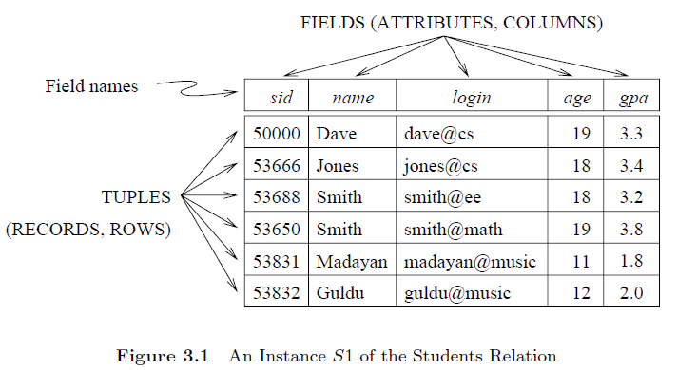
Students(sid: string, name: string, login: string, age: integer, gpa: real)
An instance of a relation is a set of tuples, also called records, in which each tuple has the same number of elds as the relation schema. A relation instance can be thought of as a table in which each tuple is a row, and all rows have the same number of fields.
Note that no two rows are identical. This is a requirement of the relational model, each relation is defined to be a set of unique tuples or rows.

Slide 3
The degree, also called arity, of a relation is the number of fields. The cardinality of a relation instance is the number of tuples in it.
A relational database is a collection of relations with distinct relation names. The relational database schema is the collection of schemas for the relations in the database.
Ordering of tuples within a relation: A relation is a set of tuples. Tuples in a relation need not have particular order. Rows can be re-ordered/Interchanged in the table.
Ordering of values within a value: An n-tuple is an ordered list of n values, so ordering of values in a tuple is important.
Values in a tuple: Each value in a tuple is an atomic value, i.e., it cannot be subdivided further. No composite, multi-valued attributes are allowed in Relational model.
For example in the address, the composite attribute "Bangalore, Karnataka, 560051" is not allowed, while is can be replace with simple attributes like City: “Bangalore”, State: “Karnataka”, Pin: 560051. Nulls in a tuple: Null value is either unknown or not applicable

Slide 4
Constraints on databases can be categorized as follows:
Inherent model-based (or implicit): constraints that are inherent in the definition/assumptions of a particular data model hold in every database having that data model as its underpinning. For example, in the relational model, no two tuples in a relation can be duplicates.
Schema-based: They enforce rules at the schema level to maintain data integrity. They can be expressed using DDL (data definition language), for example, age between 22 and 65.
Application-based: are specific to the “business rules” of the miniworld and are typically difficult or impossible to express and enforce within the data model. Hence, it is left to application programs to enforce. For example, No employee may have a salary greater than that of her supervisor.

Slide 5
Constraints in Relational Database Model
In Relational Database Model , constraints are guidelines or limitations imposed on database tables to maintain the integrity, correctness, and consistency of the data.
Constraints can be used to enforce data linkages across tables, verify that data is unique, and stop the insertion of erroneous data. A database needs constraints to be imposed on to be reliable and of high quality.

Slide 6
The following can be guaranteed via constraints:
Data Accuracy − Data accuracy is guaranteed by constraints, which make sure that only true data is entered into a database. For example, a limitation may stop a user from entering a negative value into a field that only accepts positive numbers.
Data Consistency − The consistency of data in a database can be upheld by using constraints. These constraints are able to ensure that the primary key value in one table is followed by the foreign key value in another table.
Data integrity − The accuracy and completeness of the data in a database are ensured by constraints. For example, a constraint can stop a user from putting a null value into a field that requires one.

Slide 7
Integrity constraint (IC)
An integrity constraint (IC) is a condition that is specified on a database schema, and restricts the data that can be stored in an instance of the database. If a database instance satisfies all the integrity constraints specified on the database schema, it is a legal instance.
Types of Constraints in Relational Database Model
Domain Constraints
Key Constraints
Entity Integrity Constraints
Referential Integrity Constraints

Slide 8
Domain Constraints
In a database table, domain constraints are guidelines that specify the acceptable values for a certain property or field. These restrictions guarantee data consistency and aid in preventing the entry of inaccurate or inconsistent data into the database.
The following are some instances of domain restrictions in a Relational Database Model −
Data type constraints − These limitations define the kinds of data that can be
kept in a column. A column created as VARCHAR can take string values, but a
column specified as INTEGER can only accept integer values.
Length Constraints − These limitations define the largest amount of data that
may be put in a column. For instance, a column with the definition
VARCHAR(10) may only take strings that are up to 10 characters long.
Range constraints − The allowed range of values for a column is specified by range restrictions. A column designated as DECIMAL(5,2), for example, may only take decimal values up to 5 digits long, including 2 decimal places.

Slide 9
Nullability constraints − Constraints on a column's capacity to accept NULL values are known as nullability constraints. For instance, a column that has the NOT NULL definition cannot take NULL values.
Unique constraints − Constraints that require the presence of unique values in a column or group of columns are known as unique constraints. For instance, duplicate values are not allowed in a column with the UNIQUE definition.
Check constraints − Constraints for checking data: These constraints outline a requirement that must hold for any data placed into the column. For instance, a column with the definition CHECK (age > 0) can only accept ages that are greater than zero.

Slide 10
A Key constraint is a statement that a certain minimal subset of the fields of a relation is a unique identifier for a tuple. A candidate key is a minimal set of attributes that can uniquely identify a tuple (record) in a table. we often abbreviate this to just key.
Candidate key: definition two statements to be seen.
1. Two distinct tuples in a legal instance (an instance that satisfies all ICs, including the key constraint) cannot have identical values in all the fields of a key.
2. No subset of the set of fields in a key is a unique identifier for a tuple.

Slide 11
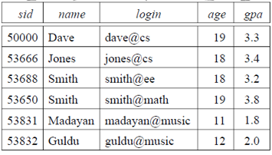
The set of fields {sid, name} is not a candidate key for Students, because this set properly contains the key sid. The set {sid, name} is an example of a superkey, which is a set of fields that contains a key.
login and age fields of the Students relation may, taken together, also identify students uniquely.
By stating that {login, age} is a key, the user is declaring that two students may have the same login or age, but not both.

Slide 12
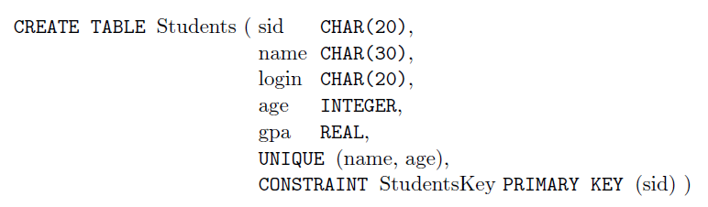
Primary Key Constraint − Out of all the available candidate keys, a database designer can identify a primary key. A primary key constraint is an individual identifier for each record in a database. It guarantees that each database entry contains a single, distinct value—or a pair of values—that cannot be null—as its method of identification.
Practice questions is uploaded in VTOP course page regarding ER models. Please refer.

Slide 13
Entity Integrity Constraints
Entity integrity ensures that no primary key is null. The primary key uniquely identifies each row in a table, and having it ensures that no two rows are identical. This constraint is crucial for maintaining the uniqueness and identifiability of records in a table.
Take the “students" table, for instance, which has the columns “sid" and "Name“ etc. The table's primary key is the sid column.
An EIC on this table would make sure that each row's unique sid value is there and that it is not null.

Slide 14
Referential Integrity Constraints
Referential integrity ensures that a foreign key value always points to an existing, valid record in another table. It maintains the logical relationships between tables, ensuring that relationships between tables remain consistent
RICs make sure there are no referential errors and that these relationships are legitimate.

Slide 15
Foreign Key Constraint − Reference to the primary key in another table is a
foreign key constraint. It ensures that the values of a column or set of columns in one table correspond to the primary key column(s) in another table.
Suppose in addition to students relation we have second relation:
Enrolled(sid: string, cid: string, grade: string)
To ensure that only bonafide students can enroll in courses, any value that appears in the sid field of an instance of the Enrolled relation should also appear in the sid field of some tuple in the Students relation. The sid field of Enrolled is called a foreign key and refers to Students.
The foreign key in the referencing relation (Enrolled, in our example) must match the primary key of the referenced relation (Students), i.e., it must have the same number of columns and compatible data types, although the column names can be different.

Slide 16
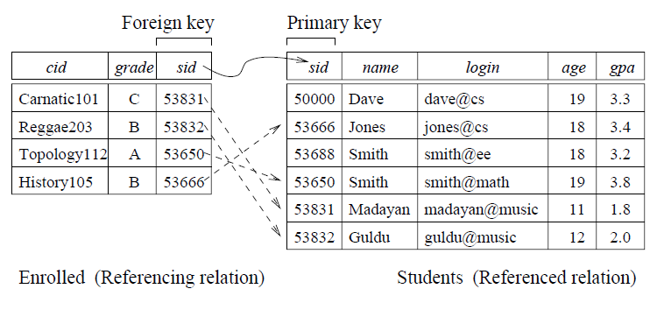
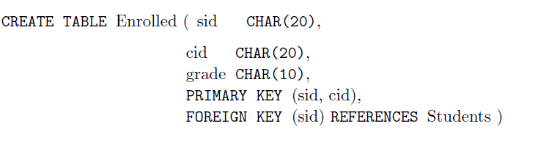

Slide 17
Foreign key: The conditions for a foreign key, given below, specify a referential integrity constraint between the two relation schemas R1 and R2.
A set of attributes FK in relation schema R1 is a foreign key of R1 that references relation R2 if it satisfies the following rules:
The attributes in FK have the same domain(s) as the primary key attributes PK of R2.
A value of FK in a tuple t1 of the current state r1(R1) either occurs as a value of PK for some tuple t2 in the current state r2(R2) or is NULL. In the former case, t1[FK] = t2[PK], and we say that the tuple t1 references or refers to the tuple t2.

Slide 18
Update Operations and Dealing with Constraint Violations: Insert Operation
Domain Constraint Violation:
Description: Occurs when an attribute value is not of the correct domain (data type, format, or allowable value).
Example: Trying to insert a string into an integer column.
Handling: Reject the insertion or update operation.
Provide a meaningful error message to the user indicating the nature of the violation.

Slide 19
Entity Integrity Violation:
Description: Occurs when any part of a primary key has a NULL value. Since primary keys must uniquely identify a record, they cannot be NULL.
Example: Trying to insert a row with a NULL value in the primary key column.
Handling: Reject the insertion or update operation.
Inform the user that primary keys cannot be NULL.

Slide 20
Key Constraint Violation:
Description: Occurs when the primary key or a unique key of a new tuple is the same as an existing tuple, violating the uniqueness constraint.
Example: Trying to insert a row with a primary key that already exists in the table.
Handling: Reject the insertion or update operation. Provide an error message indicating the duplicate key issue.

Slide 21
Referential Integrity Violation:
Description: Occurs when a foreign key value in the new tuple refers to a non-existent tuple in the referenced table.
Example: Trying to insert a row with a foreign key that does not match any primary key in the referenced table.
Handling: Reject the insertion operation. Inform the user that the foreign key value does not reference a valid tuple.

Slide 22
Update Operations and Dealing with Constraint Violations: Delete Operation.
Referential integrity violation: A referential integrity violation occurs when a tuple (row) in a table that is referenced by a foreign key in another table is deleted.
Three options for handling it:
Restrict: This option rejects the deletion of the referenced tuple, preventing any referential integrity violation.
Use Case: Use when it is crucial to keep the referencing tuples intact.
2. Cascade (or propagate) the deletion by deleting tuples that reference
the tuple that is being deleted.
Use Case: Use when the deletion of a tuple logically implies the deletion of
all related tuples.
Set null or set default, When a referenced row in the parent table is deleted or updated, the foreign key values in the child table are set to NULL. or changed to default value.
Use Case: Use when you want to maintain the referencing tuples but
indicate that they no longer have a valid reference.

Slide 23
Restrict:
CREATE TABLE Departments (
DepartmentID INT PRIMARY KEY,
DepartmentName VARCHAR(100)
);
CREATE TABLE Employees (
EmployeeID INT PRIMARY KEY,
EmployeeName VARCHAR(100),
DepartmentID INT,
FOREIGN KEY (DepartmentID) REFERENCES Departments(DepartmentID)
ON DELETE RESTRICT
);

Slide 24
Cascade
CREATE TABLE Departments (
DepartmentID INT PRIMARY KEY,
DepartmentName VARCHAR(100)
);
CREATE TABLE Employees (
EmployeeID INT PRIMARY KEY,
EmployeeName VARCHAR(100),
DepartmentID INT,
FOREIGN KEY (DepartmentID) REFERENCES Departments(DepartmentID)
ON DELETE CASCADE
);

Slide 25
Set null
CREATE TABLE Departments (
DepartmentID INT PRIMARY KEY,
DepartmentName VARCHAR(100)
);
CREATE TABLE Employees (
EmployeeID INT PRIMARY KEY,
EmployeeName VARCHAR(100),
DepartmentID INT,
FOREIGN KEY (DepartmentID) REFERENCES Departments(DepartmentID)
ON DELETE SET NULL
);

Slide 26
Set default
CREATE TABLE Departments (
DepartmentID INT PRIMARY KEY,
DepartmentName VARCHAR(100)
);
CREATE TABLE Employees (
EmployeeID INT PRIMARY KEY,
EmployeeName VARCHAR(100),
DepartmentID INT DEFAULT 1,
FOREIGN KEY (DepartmentID) REFERENCES Departments(DepartmentID)
ON DELETE SET DEFAULT
);

Slide 27
If we try to insert the tuple 55555, Art104, A into E1, which integrity constraint violation happens.

Slide 28
If we try to insert the tuple 55555, Art104, A into E1, which integrity constraint violation happens.
the RIC is violated because there is no tuple in students relation with the id 55555; the database system should reject such an insertion.

Slide 29
Similarly, if we delete the tuple 53666, Jones, jones@cs, 18, 3.4 from students relation.

Slide 30
Similarly, if we delete the tuple 53666, Jones, jones@cs, 18, 3.4 from students relation.
we violate the RIC because the tuple 53666, History105, B in enrolled relation contains sid value 53666, the sid of the deleted Students tuple.

Slide 31
Update Operations and Dealing with Constraint Violations: Update Operation
Key constraint violation: primary key is changed to another value which is same as another tuple’s primary key value.
Referential integrity violation: A referential integrity violation during an update operation:
When an update is done in parent table which are referenced by child table.
Note: The Restrict, Cascade and Set NULL can be used to deal with these violations

Slide 32
An update can cause violations, similar to an insertion:
UPDATE Students SET sid = 50000 WHERE sid = 53688.

Slide 33
An update can cause violations, similar to an insertion:
UPDATE Students SET sid = 50000 WHERE sid = 53688.
This update violates the primary key constraint because there is already a tuple with sid 50000.

Slide 34
CREATE TABLE Departments (
DepartmentID INT PRIMARY KEY,
DepartmentName VARCHAR(100)
);
CREATE TABLE Employees (
EmployeeID INT PRIMARY KEY,
EmployeeName VARCHAR(100),
DepartmentID INT,
FOREIGN KEY (DepartmentID) REFERENCES Departments(DepartmentID)
ON UPDATE CASCADE
);

